Slide 1


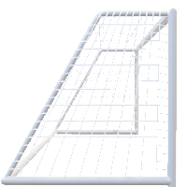
WITH LINEAR REGRESSION
BERNARD OPOKU

Slide 2
INTRO
FPL
Players
DATA
Source
Collection
PROCESS
EDA
MODELING
FINAL THOUGHT
RESULTS
FUTURE WORK
.

Slide 3
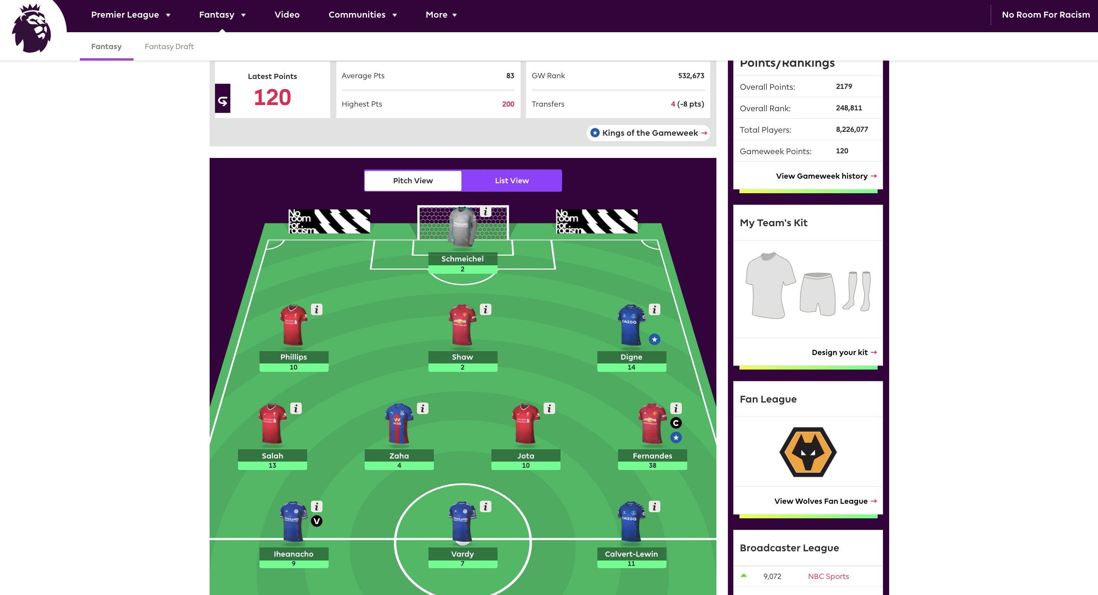


INTRO
FPL
Players
Why Fantasy premier League
Lets talk abour fpl and how points are scored
.

Slide 4
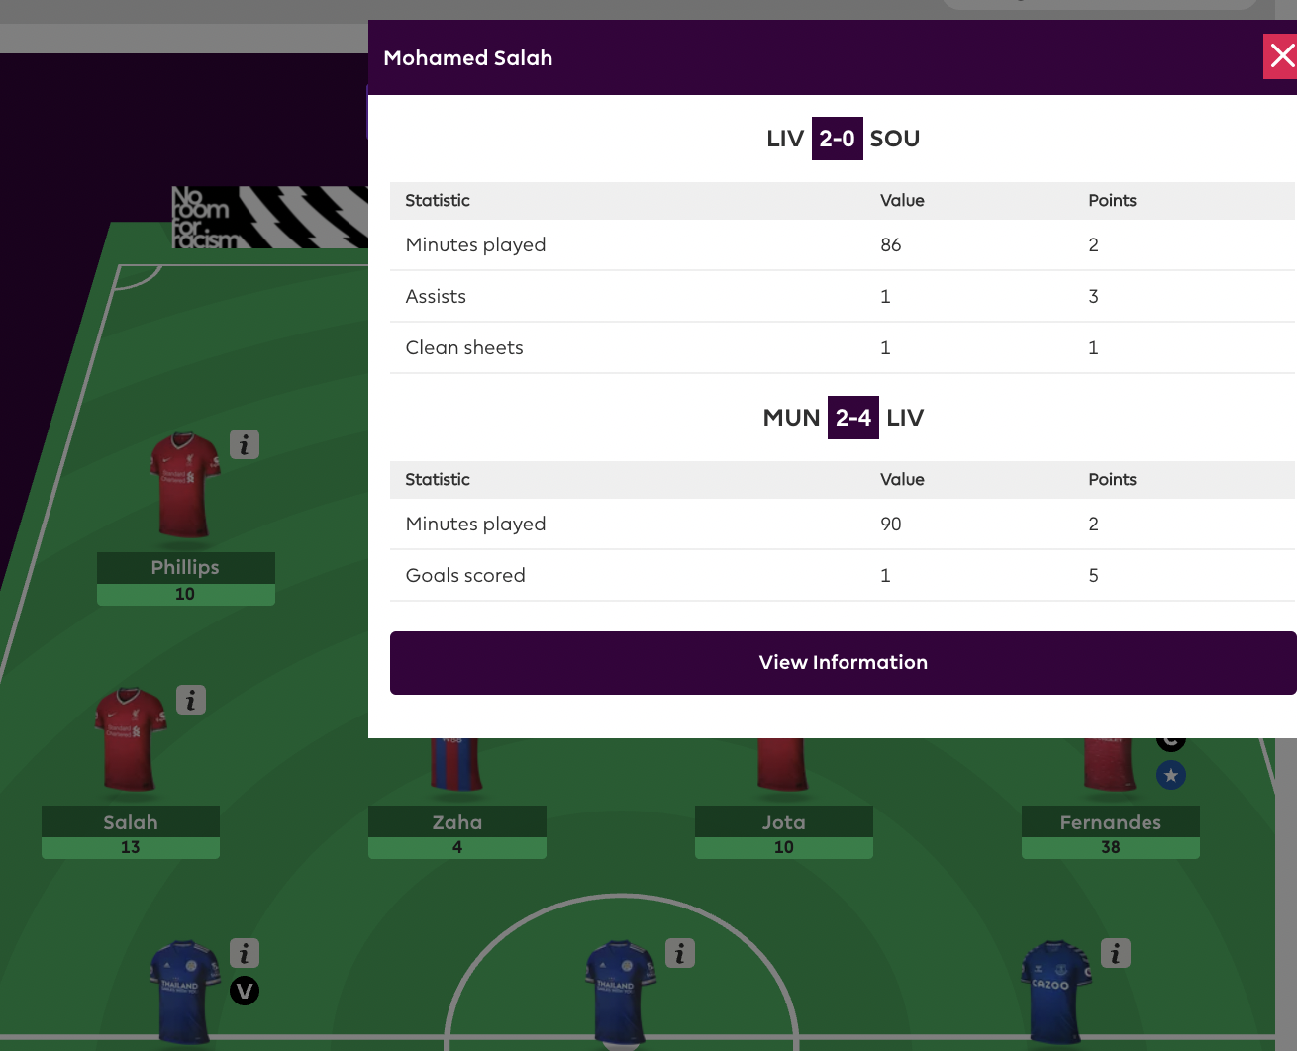
Players
INTRO
FPL
How Are Players Scored?
What do you need to do as a ManagerS.
.
Role of this project/ ML/LR?

Slide 5
INTRO
FPL
Players
DATA
Source
Collection
PROCESS
EDA
MODELING
FINAL THOUGHT
RESULTS
FUTURE WORK
.

Slide 6
DATA
Source
Collection
Selenium
BeautifulSoup
ChromeDriver
Fantassy.premierleague.com
Over 600 player
33 weeks
Over 30 features
.
Total of 20,000 Rows of data

Slide 7
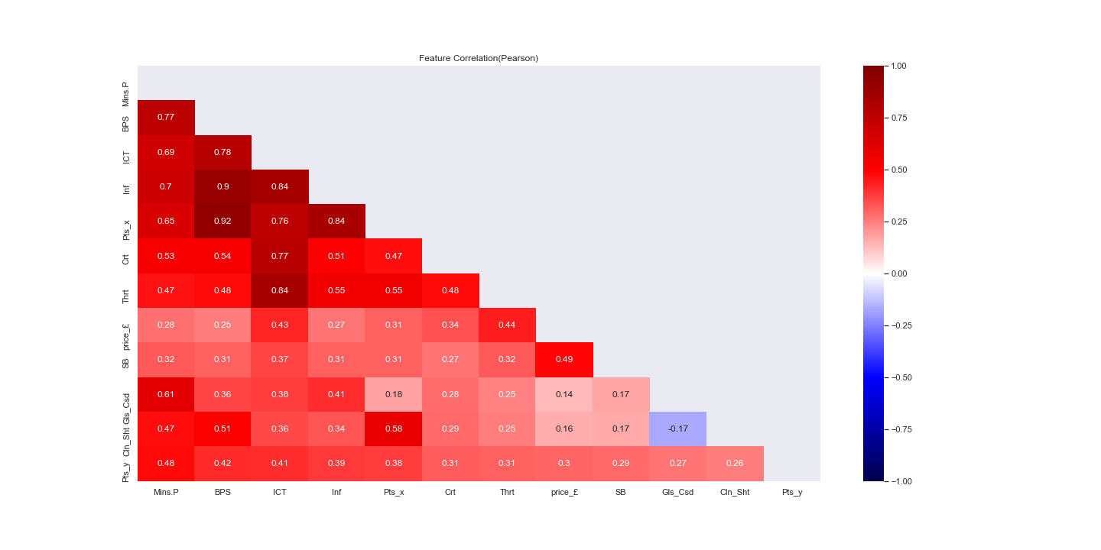
PROCESS
EDA
MODELING
.

Slide 8
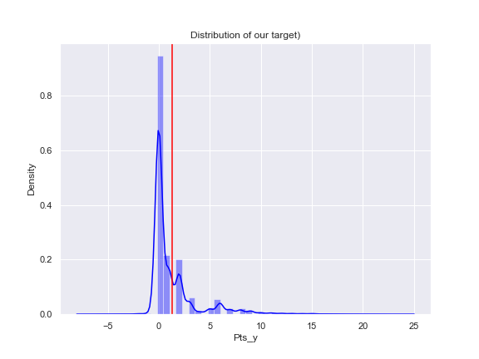
PROCESS
EDA
MODELING
.
- Not normal
Skewed-Right

Slide 9
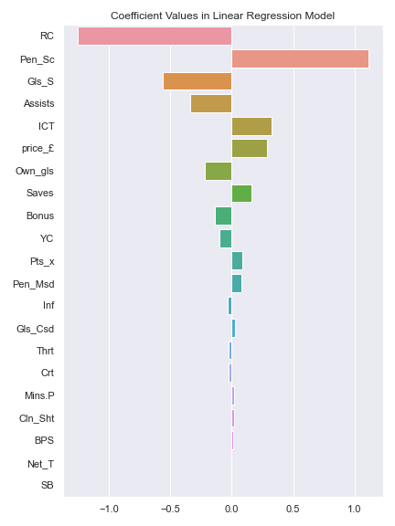
PROCESS
EDA
MODELING
Simple Linear Regression with select features
.
R^2= 2.29
MSE= 4.60
MAE= 1.22

Slide 10
PROCESS
EDA
MODELING
More Features
Feature Engineering
.
Dummy Variables
Feature Interactions
Different Linear Regression Methods

Slide 11
PROCESS
EDA
MODELING
Degree2 poly
TR_R^2=.60
Val_R^2 =-0.3
Regularization
(LASSO)
Simple Linear Regression with select features
.
R^2= 2.29
MSE= 4.60
MAE= 1.22

Slide 12
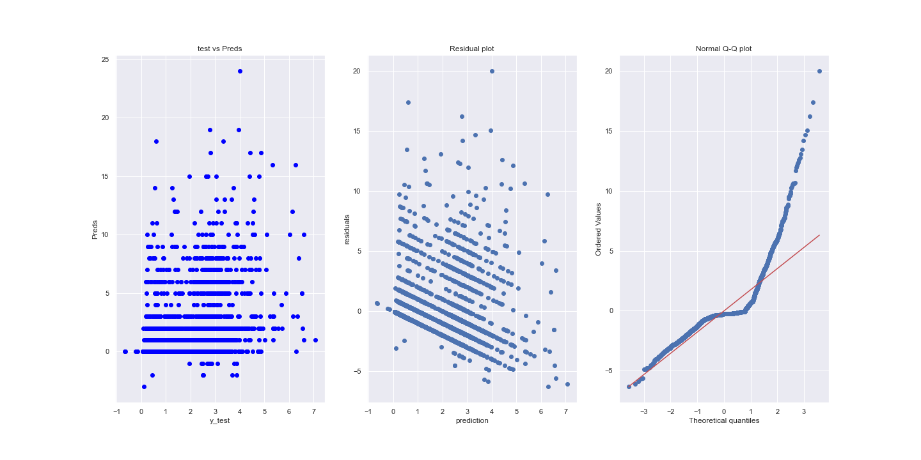
PROCESS
EDA
MODELING
Simple Linear Regression with select features
R^2= 2.29
MSE= 4.60
MAE= 1.22
.

Slide 13
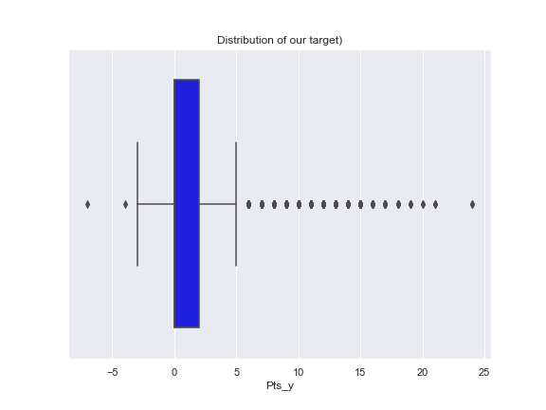
PROCESS
EDA
MODELING
Simple Linear Regression with select features
.
R^2= 2.29
MSE= 4.60
MAE= 1.22

Slide 14
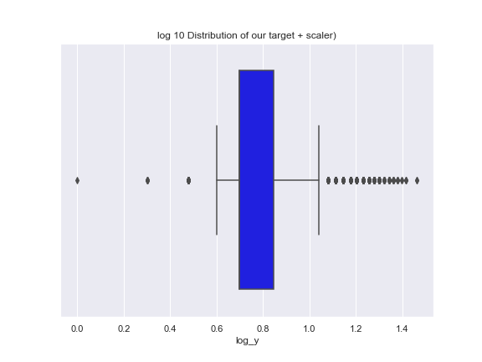
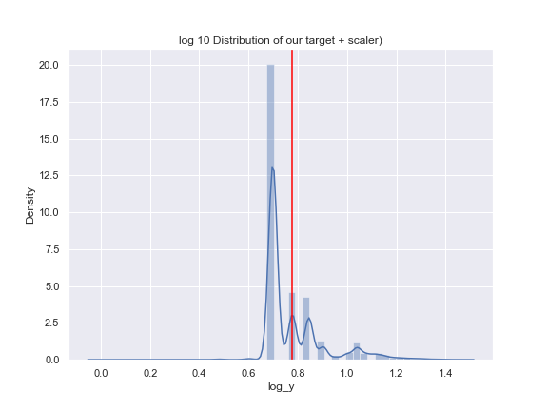
PROCESS
EDA
MODELING
LOG10 Transformation +5
R^2= .34
MSE= .01
MAE= .06
.

Slide 15
FINAL THOUGHT
RESULTS
FUTURE WORK
LOG10 Transformation +5
.
Y_pred = ((10**y_pred_tr)-5)

Slide 16
FINAL THOUGHT
RESULTS
FUTURE WORK
-More studying of the trend
-Look at team str
.

Slide 17
WITH MACHINE LE

